Slide 1
HealthCare Data Analysis Project
Group 4 Members:
Md Danish Alam
Akruti Antarvedi
Mohini Bhaskar Dhotre
Porselvi S

Slide 2

Project Details
The Internship Project Focuses On Healthcare Analytics Using A Dataset That Contains Detailed Information About Various Healthcare Facilities. The Dataset Includes Key Metrics Related To Operational Status, Financial Performance, And Patient Care. Here Are The Main Points To Cover In The Overview.
Key Objectives:
Data Exploration: Understanding metrics like licensed beds, patient demographics, etc.
Financial Analysis: Evaluating revenues and expenses for cost optimization.
Performance Metrics: Service utilization rates for efficiency.
Visualization: Communicating findings through visual representations.

Slide 3
Challenges Faced During the Project
Data Quality Issues: Inconsistencies, missing values, and duplicates.
Data Modeling Complexity: Representing relationships among metrics accurately.
Integration of Diverse Data Sources: Challenges in merging data formats.
Stakeholder Communication: Simplifying complex findings for varied expertise.

Slide 4
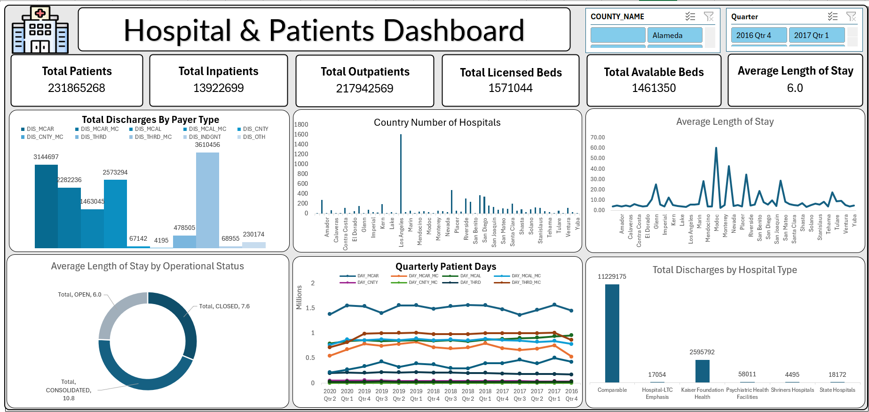

Slide 5
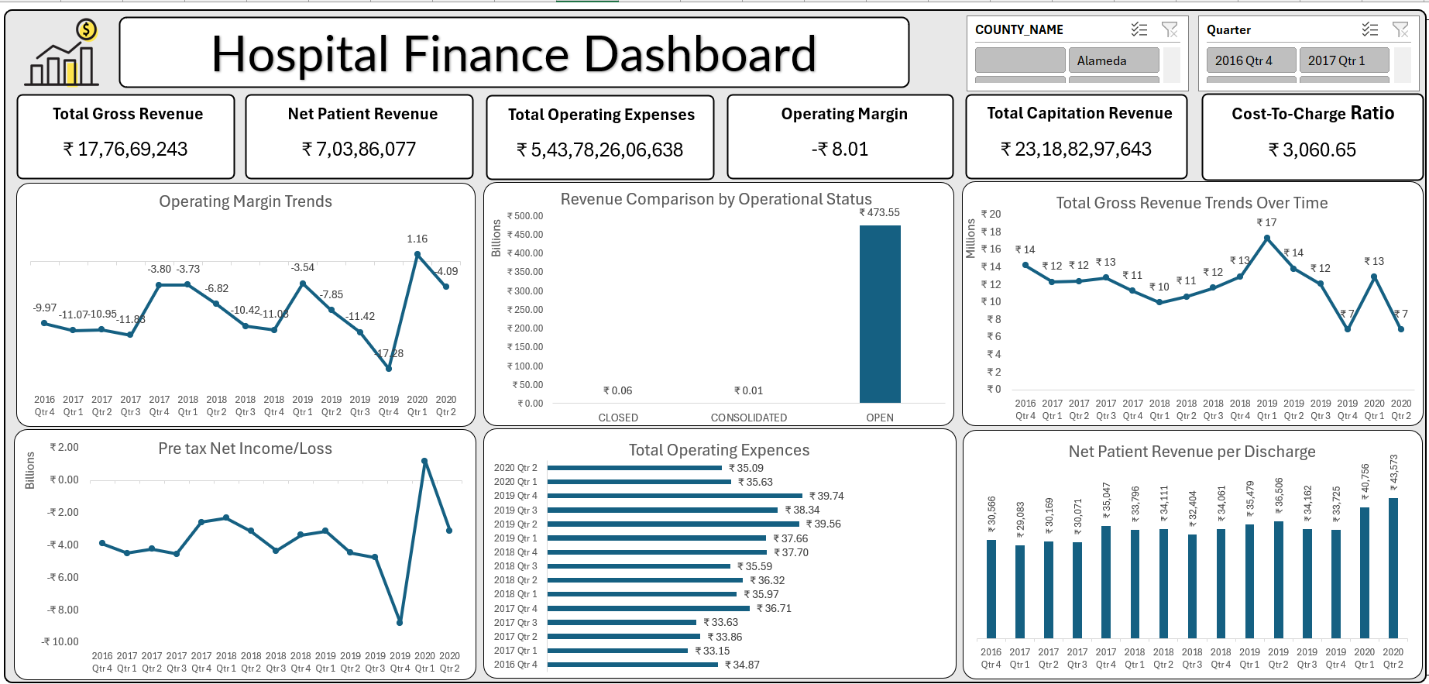

Slide 6
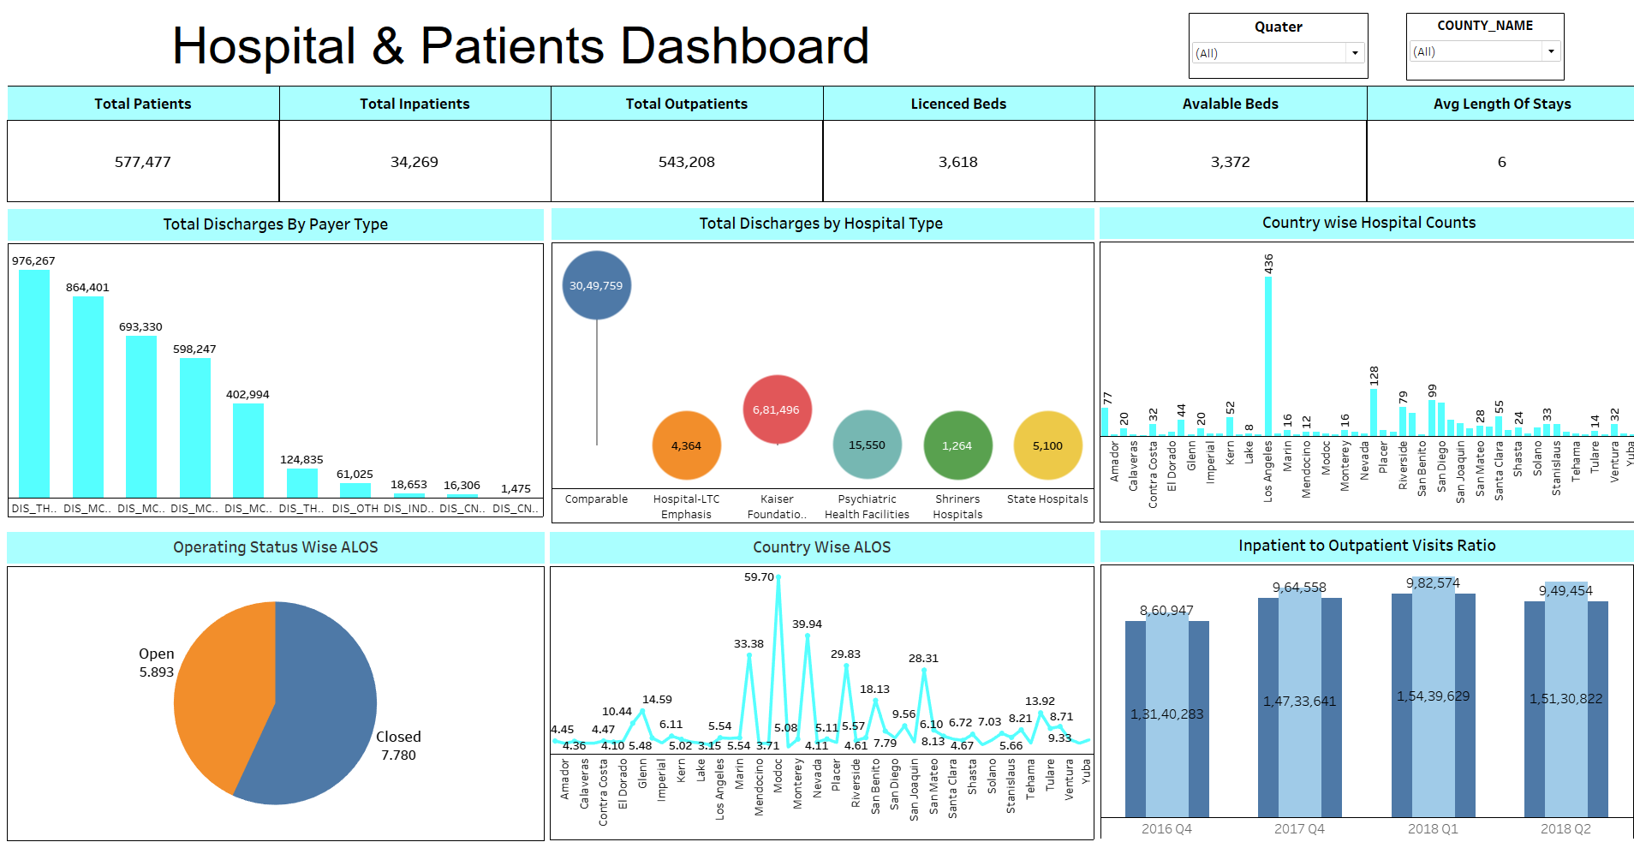

Slide 7
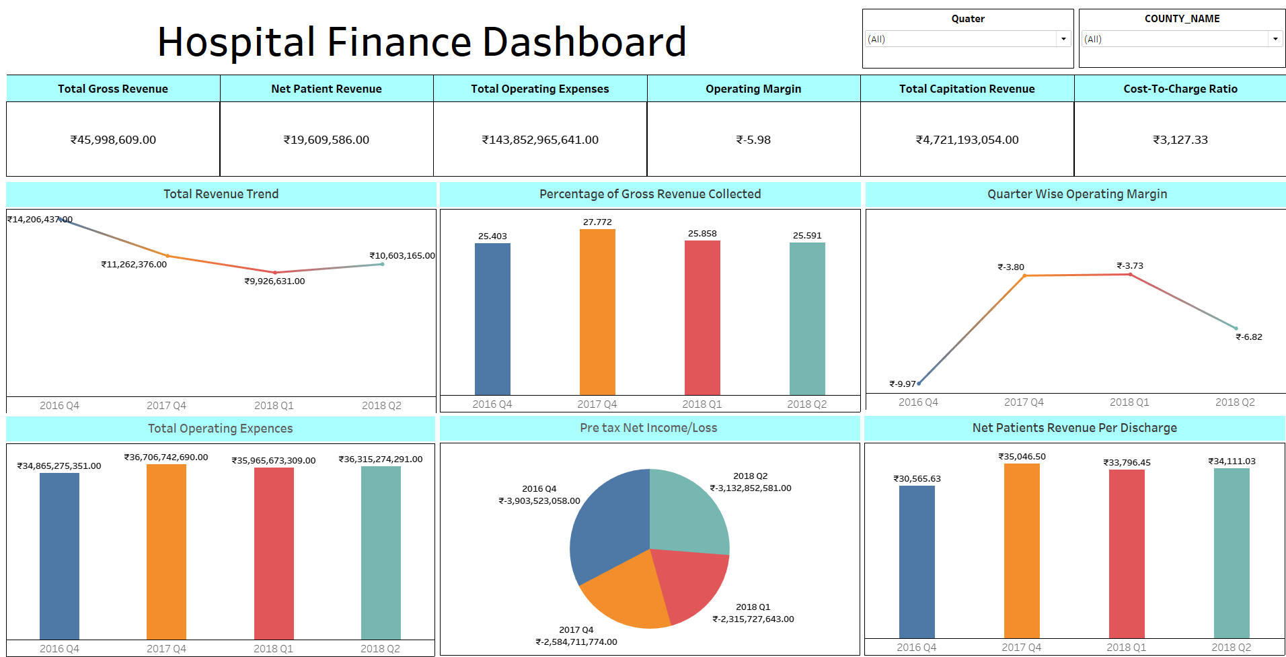

Slide 8
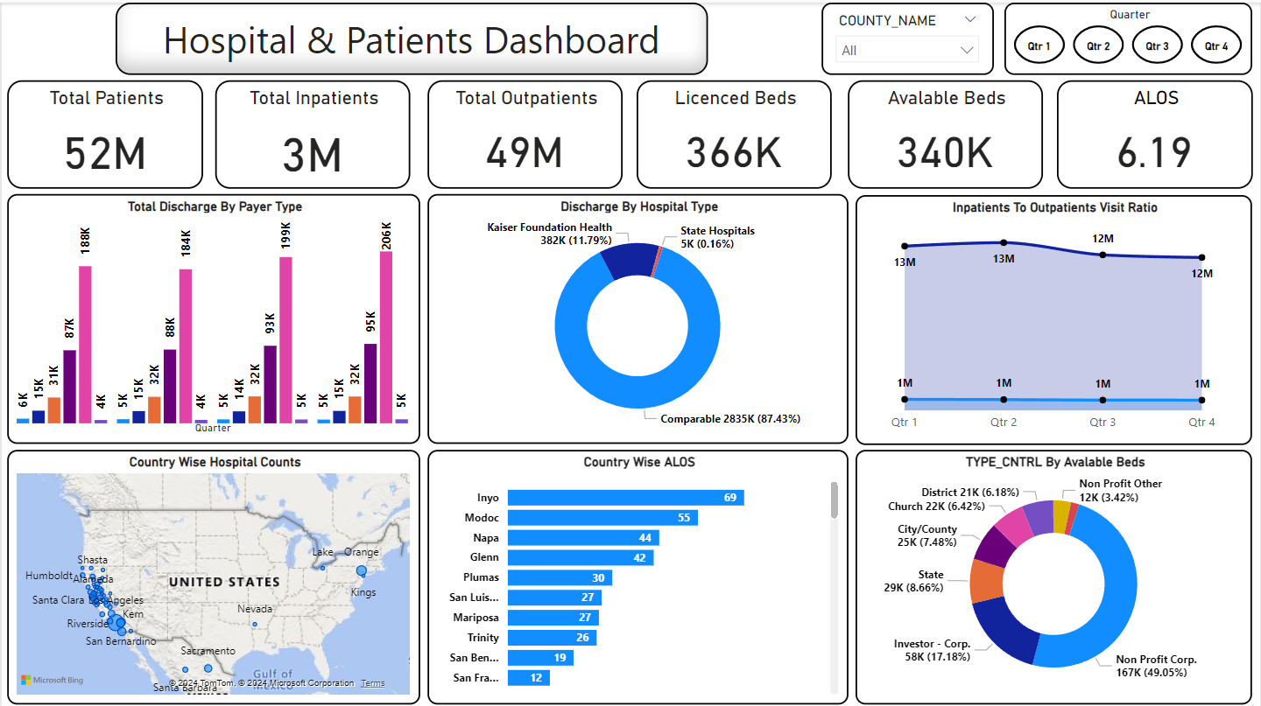

Slide 9
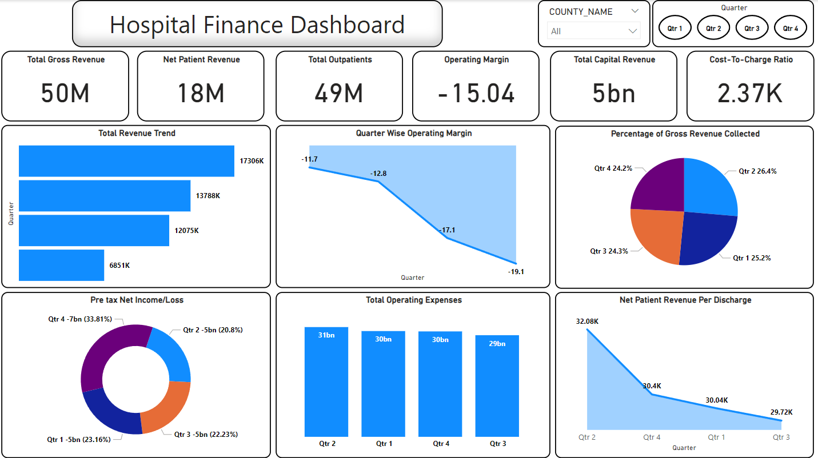

Slide 10
Patients & Hospital Dashboard

Slide 11
KPI 1: Total Discharge by Payer Type
Key Insights:
Medicare and MediCal discharges show a steady decline.
Indigent and Thirdparty payers contribute marginally.
Solutions:
Review seasonal trends or policy changes for Medicare/MediCal decline.
Expand outreach to underrepresented payer types.
Engage payer organizations to streamline systems.

Slide 12
KPI 2: Discharge by Hospital Type
Key Insights:
Comparable Hospitals dominate with 87.4% discharges.
Kaiser and psychiatric facilities play smaller roles.
Solutions:
Optimize resources for Comparable Hospitals.
Expand psychiatric services to meet mental health needs.

Slide 13
KPI 3: CountyWise Hospital Counts
Key Insights:
Los Angeles has the highest hospital count; Amador is underserved.
Solutions:
Increase infrastructure in underserved counties.
Deploy telemedicine and mobile units.

Slide 14
KPI 4: Inpatient to Outpatient Visit Ratio
Key Insights:
Outpatient visits declined slightly, while inpatient stays remained stable.
Solutions:
Investigate outpatient decline causes.
Align staffing with inpatient demand.

Slide 15
KPI 5: CountyWise Average Length of Stay (ALOS)
Key Insights:
Inyo County has the highest ALOS; Mono County has the shortest ALOS.
Solutions:
Analyze high ALOS causes in Inyo County.
Standardize care to reduce delays.

Slide 16
KPI 6: Available Beds by Type of Control
Key Insights:
NonProfit Corporations control 50% of available beds.
Solutions:
Diversify funding sources to balance healthcare access.

Slide 17
Hospital Finance Dashboard

Slide 18
KPI 1: Total Revenue Trends
Key Insights:
Revenue shows a consistent decline, starting from 17.3M in Q1 and dropping sharply to 6.9M in Q4.
The steepest drop occurs in Q4 (43.3%), raising concerns about seasonal or structural revenue shortfalls.
Solutions:
1. Identify the root cause of the Q4 drop—whether due to operational inefficiencies, patient volume decline, or reimbursement delays.
2. Diversify revenue through new services, such as outpatient specialty care or telemedicine.
3. Strengthen partnerships with insurers to ensure timely reimbursements.

Slide 19
KPI 2: QuarterWise Operating Margin
Key Insights:
Operating margins are negative throughout the year, worsening from 11.7 in Q1 to 19.1 in Q4.
Solutions:
1. Conduct an expense audit to identify highcost areas and eliminate inefficiencies.
2. Introduce flexible cost models, such as seasonal staffing or variable supply procurement.
3. Focus on highmargin services to offset losses from lowmargin operations.

Slide 20
KPI 3: Percentage of Gross Revenue Collected
Key Insights:
Revenue collection percentages remain relatively stable, peaking at 26.4% in Q2, but slightly declining to 24.2% in Q4.
Solutions:
1. Leverage Q2 collection strategies in other quarters—focus on optimized billing cycles or insurer negotiations.
2. Implement AI tools to enhance accuracy in billing and reduce collection delays.

Slide 21
KPI 4: PreTax Net Income/Loss
Key Insights:
Consistent losses of 5B per quarter, with a sharp rise to 7B in Q4, accounting for 33.8% of annual losses.
Solutions:
1. Analyze highimpact loss areas and address recurring inefficiencies.
2. Introduce cost control measures, such as renegotiating contracts with suppliers or insurers.
3. Explore alternative revenue streams, such as leasing equipment or expanding into highdemand services.

Slide 22
KPI 5: Total Operating Expenses
Key Insights:
Operating expenses remain high, peaking at 31B in Q2 but showing slight reductions in Q3 (29B).
Solutions:
1. Review and streamline Q2 expenditure to identify areas for cost reduction.
2. Introduce automation in administrative tasks to minimize recurring operational costs.
3. Evaluate vendor contracts to negotiate better pricing on supplies and services.

Slide 23
KPI 6: Net Patient Revenue Per Discharge
Key Insights:
Revenue per discharge declines slightly from 32K in Q2 to 30.4K in Q4, potentially due to payer mix or service inefficiencies.
Solutions:
1. Focus on attracting highrevenue patient segments through targeted marketing and partnerships.
2. Conduct a detailed review of billing practices to ensure all procedures and services are accurately charged.

Slide 24

Healthcare Project: Hospital Patient Dashboard Conclusions
Hospital and Patient Dashboard:
On the patient side, key insights from the Hospital and Patient Dashboard include trends in patient admissions, treatment costs, and satisfaction. A decline in patient admissions during certain quarters aligns with the revenue drop observed in the financial dashboard. Furthermore, treatment costs remain relatively high, and patient satisfaction, though generally positive, shows signs of declining in specific areas, particularly in waiting times and treatment efficiency.
To mitigate these concerns, the hospital should invest in enhancing patient care services, particularly in areas impacting satisfaction, such as reducing wait times and improving communication. It is also crucial to ensure that patient treatment costs align with revenue generation, focusing on optimizing resource allocation without compromising care quality.
Overall Conclusion:
Both dashboards point to the need for a comprehensive approach to improving financial health and patient care. The hospital must focus on revenue diversification, improving cost efficiency, enhancing billing accuracy, and optimizing patient care services. By implementing these strategies, the hospital can achieve financial sustainability while maintaining a high standard of patient care.

Slide 25
Healthcare Project: Hospital Finance Dashboard Conclusions
Hospital Finance Dashboard:
The hospital is facing a steady decline in revenue, with a notable drop from 17.3M in Q1 to 6.9M in Q4, indicating potential seasonal or structural inefficiencies. The operating margin is negative throughout the year, worsened by Q4 losses, which account for 33.8% of annual losses. The Pre-Tax Net Income consistently shows losses, exacerbated in Q4, and operating expenses remain high despite slight reductions in Q3.
To address these issues, the hospital needs to investigate the reasons behind the Q4 revenue drop, optimize its revenue collection strategies, and introduce new revenue streams like telemedicine or outpatient care. Cost-cutting measures, such as automating administrative tasks and renegotiating supplier contracts, should be implemented to reduce operating expenses and improve profitability. Additionally, focusing on high-margin services and refining billing practices will help alleviate the financial pressure.

Slide 26
Thank You.

